Slide 1
Overview of R and ggplot2 for graphics
R Bootcamp 2017
Michael Hallquist

Slide 2
A layered grammar of graphics
In many software packages, each graph type is treated separately (scatter plot, pie chart, bar chart).
This leads to the burden of needing to learn the syntax or interface of each plot type.
It also obscures the reality that data can typically be visualized in many different ways (and trying out a few is usually beneficial)
A related challenge is implementing consistent decisions for colors, axis labeling, grid lines, etc.
A good grammar will allow us to gain insight into the composition of complicated graphics, and reveal unexpected connections between seemingly different graphics (Cox, 1978)

Slide 3
A layered grammar of graphics
Base dataset
Layer:
Data
Aesthetic mappings
Statistical transformation
Geometric object
Position adjustment
Scale (one for each aesthetic mapping)
Coordinate system
Facet specification

Slide 4
5 components of graphical layers
Mapping: A set of rules for translating a given variable into an attribute of the graph (e.g., age is mapped to the x axis)
Data: A dataset to be used when drawing marks (using a geom_ or stat_ function). If none is specified, the base dataset is used.
Geom: The graphical primitive to draw on the figure according to the mapping (e.g., point, text, or boxplot).
Stat: The statistical transformation or computation to use to draw marks onto the figure. (Mutually exclusive with geom)
Position: Method used to adjust overlapping data (e.g., stack, dodge)

Slide 5
Long/molten format for ggplot
Many problems with visualization reflect that data are not sufficiently wrangled and/or tidy.
Ggplot prefers data in a long format where each row is an observation and columns denote variables that can be mapped to the graph.
Thus, a response variable, height, that will mapped to the y axis needs to be in one variable, even if another variable, sex, is included for faceting. This allows for a simple tabular key-value lookup.
Remember the gather function from tidyr.

Slide 6
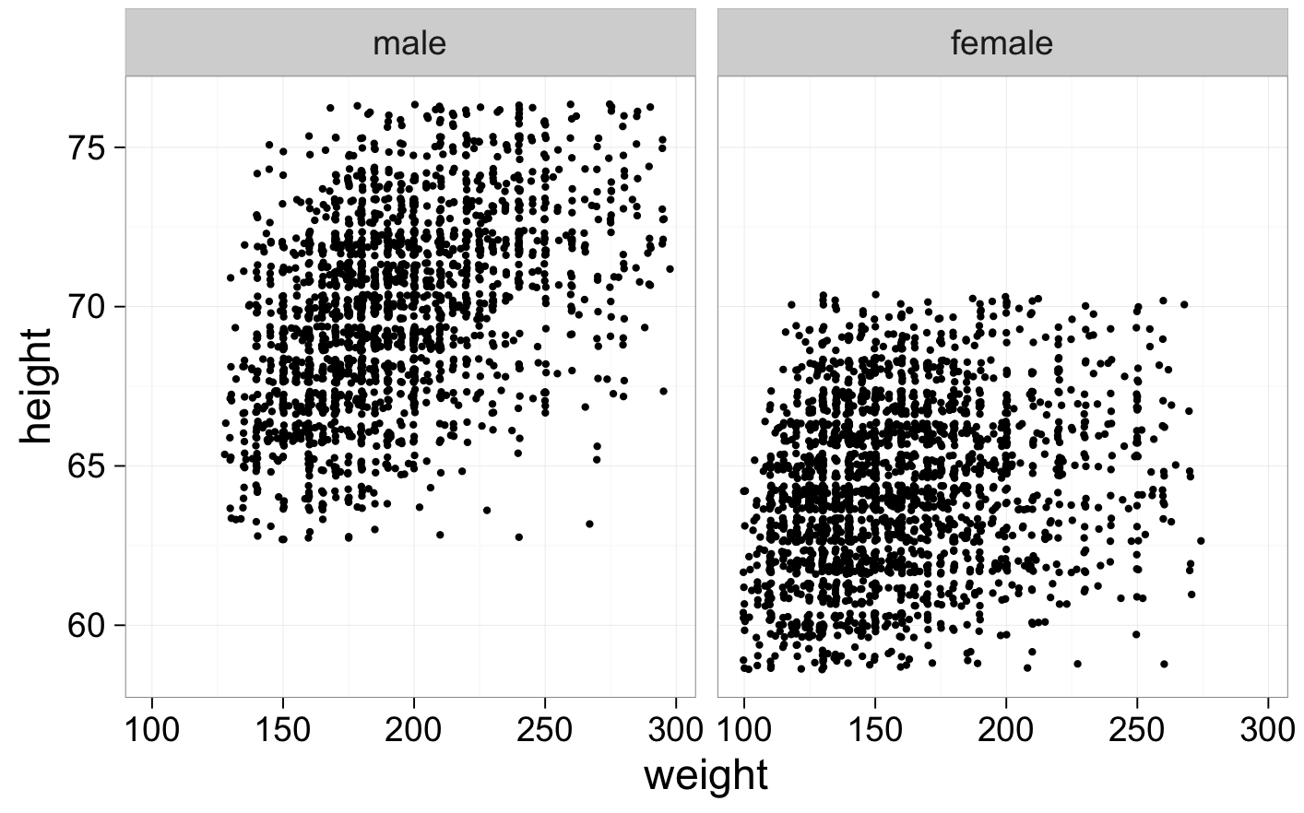
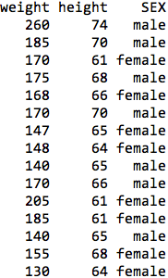
ggplot(dataset, aes(x=weight, y=height)) + geom_jitter() + facet_wrap(~SEX) + theme_bw(base_size=26)

Slide 7
Lab: Introduction to graphics devices in R
Vector graphic: uses polygons based on control points that have positions in a Cartesian coordinate system.
Simply put: Plotting information is with respect to the Cartesian plane, not the display device. Hence, vector graphics can be rescaled to any device without loss of fidelity.
Bitmap (raster) graphic: image is a rectangular grid of pixels (irreducible units) where each pixel has specific graphical properties (hue, saturation, brightness [HSB]).
The dimensions of the image can only be changed by resampling (and potentially interpolating) the original rectangular pixel grid.

Slide 8
Vector versus bitmap graphics
When possible, prefer vector graphics:
Typically smaller file size
Can be easily edited after the fact (e.g., in Inkscape)
Avoids concerns about resolution/dots per inch (DPI)
At times bitmap will be better:
Journal requires TIFF at 600 DPI (check your proofs!!)
Graphic contains photographs or other visually graded media
There are many points to display (50k+)
Small file size is paramount (e.g., for email)
Potential font embedding issues
Microsoft Office files (they're getting better)

Slide 9
Bitmaps: lossy versus lossless
Bitmap graphics can be compressed by not storing each pixel's unique HSB value on the file system (technically related to projection to a lower dimension subspace).
Lossy compression: Original HSB values discarded in favor of size optimization. Most common: .jpg
Lossless compression: Original HSB values preserved and reconstructed for display (less efficient, but no loss of information). Most common: .png, .gif

Slide 10
Recommendations for graphic output
Vector graphics:
.pdf (for publication)
.svg (for edits in Illustrator or Inkscape) -> export to PDF?
Get aspect ratio and relative font size right
Bitmap graphics:
.png (lossless compression) for charts and text
.jpg (Quality 90+) for photos or complex illustrations with tonal gradients.
Minimum DPI for printing of 240. 300-600 preferred.
Minimum DPI of 150 for displaying on screen.
Need to get width and height exactly right since resizing involves interpolation

